Slide 1
Begin with the end in mind

Slide 2
Applied to
Business Plan
Vision, Mission, Culture
Goals
Big Question
Learning
Customer Journey
Comfort zone

Slide 3
Organizational Chart
YOU
President/CEO
YOU
Office Manager
YOU
Marketing
YOU
Advertising Manager
YOU
Sales Manager
YOU
Market #1
YOU
Market #2
YOU
Operations
YOU
Delivery
YOU
Service
YOU
Finance
YOU
AP/AR
YOU
Human Resources

Slide 4
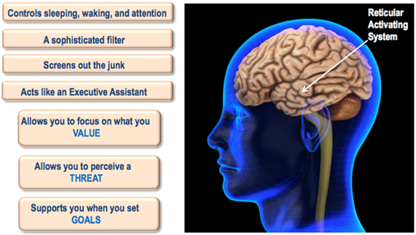
Reticular Activating System (RAS)

Slide 5
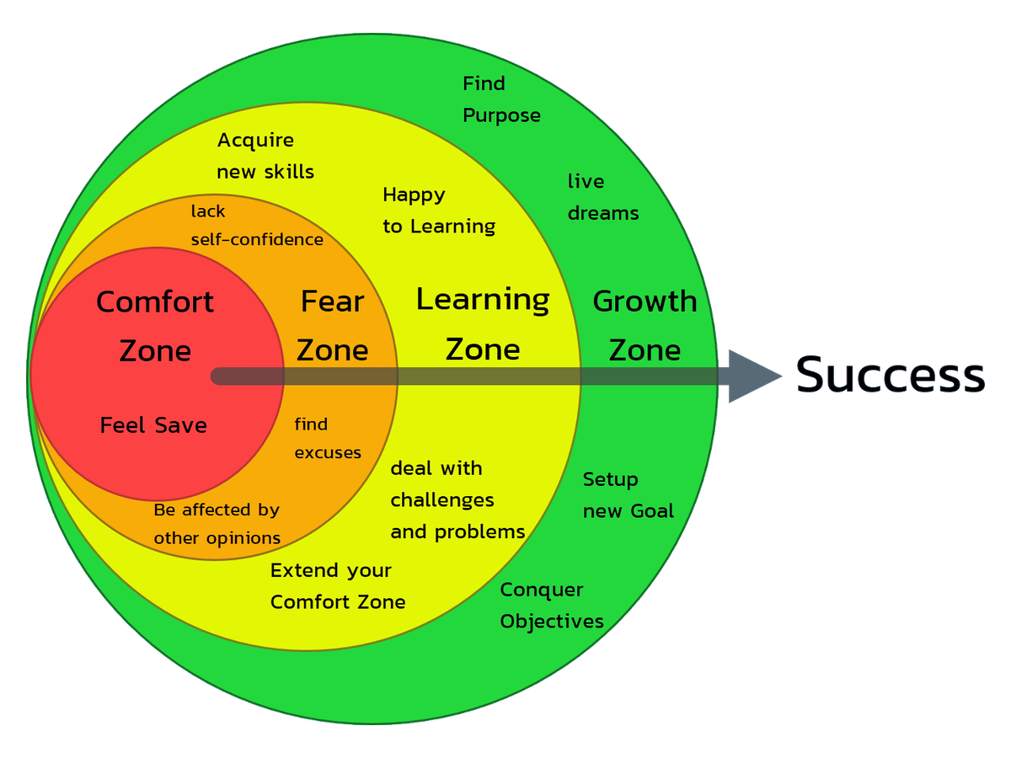
COMFORT ZONE
COMFORT ZONE
“If you are willing to do only what is easy, life will be hard.
If you will do what is hard, life will be easy.”
T HARV EKER

Slide 6
FEAR
False Expectations Appearing Real
Susan Jeffers – feel the fear and do it anyway
Stops us making our vision happen
Immensely powerful state and USEFUL state
Do not kill fear, tame fear
Proceed with caution
Creatures of habit, practice acting in spite of fear
Proceed with caution
Use it to mobilise you, not freeze you
Use it to transform you, allow it to expand you experience and comfort zone
It is there not to stop us, it is there to encourage us to do things in the correct way
Do not remove discomfort, it is not good to be comfortable
FEAR

Slide 7
UNCOMFORT ZONE
Uncomfort
zone
is best!
To grow you must move through into this
Comfort zone, over-rated, warm, fuzzy and secure – NO GROWTH
Only time you grow is in the uncomfort zone
The more comfort becomes your priority, the more contracted you become with fear
S-T-R-E-T-C-H yourself you expand your opportunity zone and more you fill it
Level 5 life (now) to Level 10 life (future)
Level 0-5 comfort
Level 6-10 – uncomfort zone
Uncomfort at first – stick with it and push on
Creatures of habit – we must practice, in spite of fear, in spite of doubt, in spite of uncertainty, in spite of inconvenience
Recognise it, don’t retreat and acknowledge your growth
If your goal is comfort please change it, please aim for discomfort
T Harv Eker – “ No one ever died of discomfort, yet, living in the name of comfort has killed more ideas, more opportunities, more actions and more growth than everything else combined. Comfort kills”

Slide 8
Taming fear
WE DON’T FAIL – WE LEARN
Recognise fear – realise you are fearful
Feel it and immerse yourself in it
Notice what is happening, emotionally & physically
Notice it, stay with it
Choose to acknowledge it, and ask what it is telling you, how can you use this
Enjoy it, enjoying noticing how fearful you are
NOW GO BEYOND THE FEAR – you have noticed what needs to be noted so deliberately
& consciously step beyond
What is the fear doing?
It is getting you to really focus – excellent
Shift mindset to imagine the fear was transformed into an unstoppable energy
Let the fear sit really comfortably with you
Imagine the situation, how would it be if you had tremendous energy? How would it be if you were focused? Now use that energy to get organized.
List exactly what you need to do to prepare and get organised, rehears - this will desensitize you to the fear
Now decide. What are the pluses? What are the negatives? Should you just do it?
Get really clear on it
Focus on the preparation
Focus on the feeling afterwards
Fear is about “what if”. What if it doesn’t / what if it does. You have widened your comfort zone whatever happens
What about failure?
TAMING FEAR

Slide 9
THOUGHTS
“Training and managing your mind is the most important skill you will ever own in terms of happiness and success”
Train your mind
You can choose your thoughts – you run your thoughts
Robert Allen – “No thought lives in your head rent free”
Negative thoughts – pay for in energy, money, time, worry,
level of happiness
Empowering & non empowering thoughts
Awareness and observation
Are they supportive to your success and happiness
Change them to empowering ones
Power thinking v positive thinking
TRAIN YOUR MIND

Slide 10
Thank you!

